Slide 1
FFT/IFFT
by
Ilayda & Allan

Slide 2
Requirements
Completed tasks
    Research
    Architecture
    Behavioral model (Matlab)
    Functional design (VHDL)

Slide 3
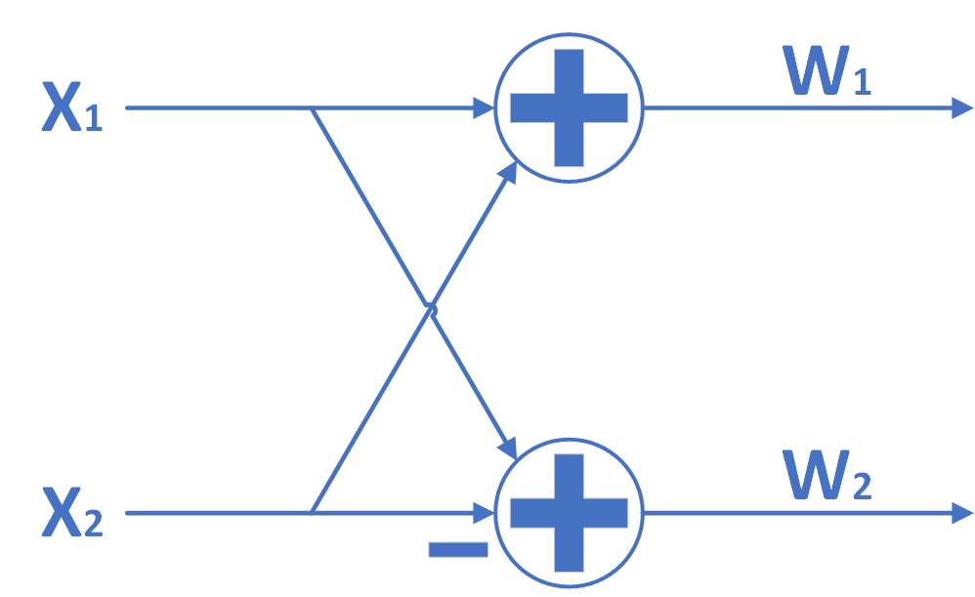
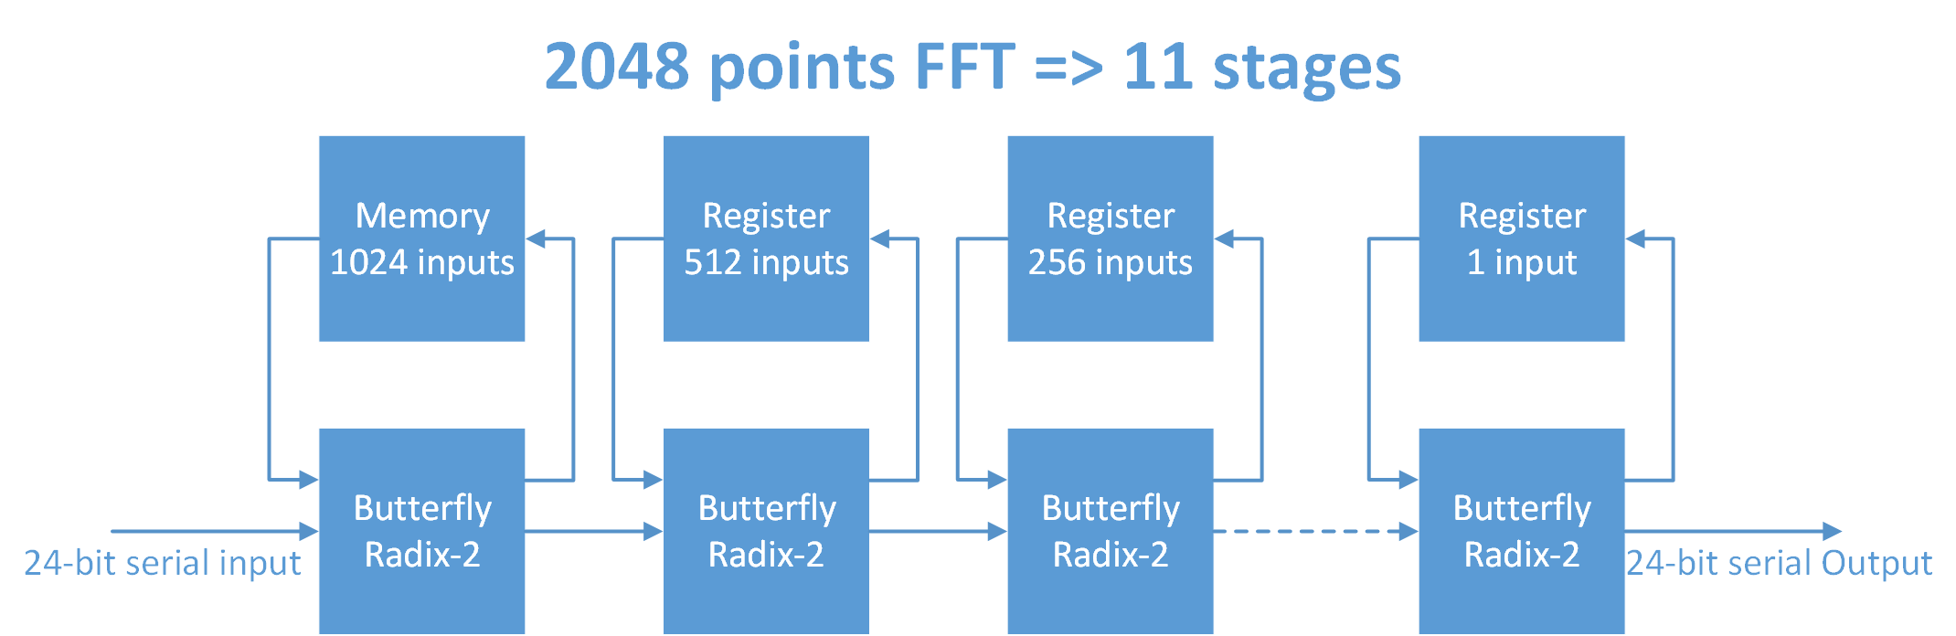
Architecture

Slide 4
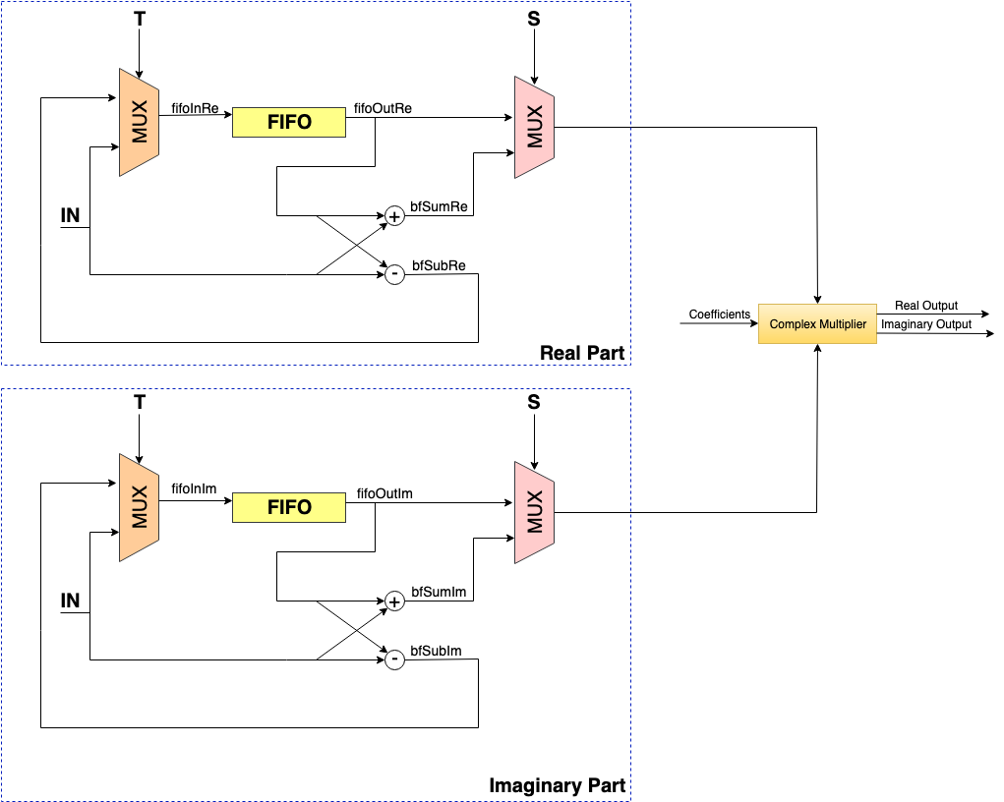
SDF Architecture

Slide 5
Verification
Simulation in progress using Vivado comparing with the Matlab model.
Random input data is generated in Matlab ranging from -1 to 1(fractional numbers).

